Slide 1

EVALUATING THE EFFECTIVENESS OF AN 'AWARENESS AGENT' IN MANAGING DIGITAL INFORMATION OVERLOAD
A PhD research project with the Open University Knowledge Media Institute
David goddard
January 2024
{

Slide 2


















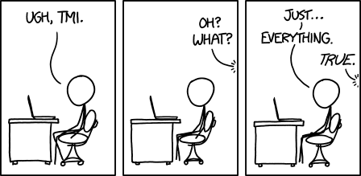




Too much information?
Online collaborative & social environments are full of information and interactions from many sources
Users experience problems with:
Finding the items that most interest them
Locating useful and relevant information
Being able to take timely action where needed
We are using the Computer Supported Cooperative Work (CSCW) concept of “awareness” to formalise the problem
We are looking at this problem in the context of both work and social computing
https://xkcd.com/1369/

Slide 3
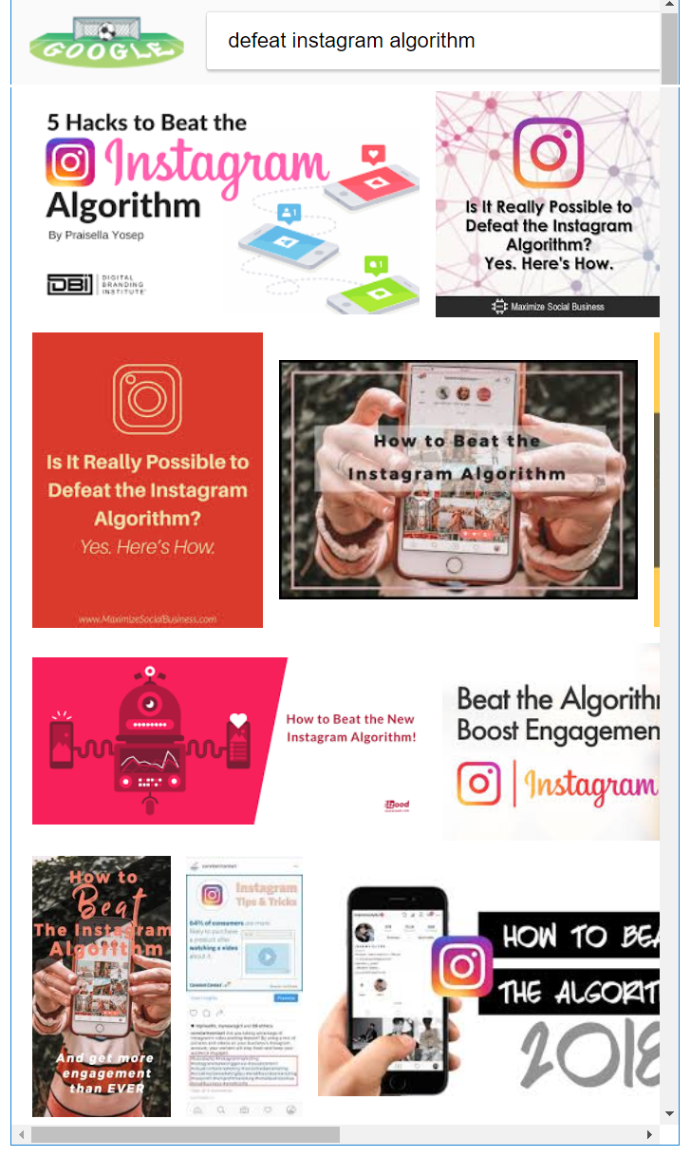


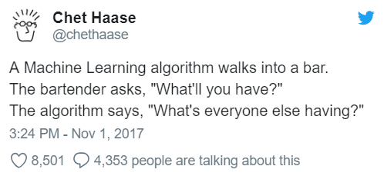

Who and what do we trust?
Algorithms are increasingly used to determine what we see and when
We don’t own or control these algorithms
Do we trust them?
Do they do a good job?
Could our own ones do better?
etc.!
“The goal of News Feed is to show you the stories that matter most to you”
- Facebook
https://slate.com/technology/2018/06/i-left-facebook-for-10-days-and-facebook-did-not-let-me-forget-it.html

Slide 4
How do we access information?
Different services usually have their own user interfaces
Some integrate with other things, some do not
User may not have choice in all the information sources they have to use
Diversity of interfaces adds to information overload

Slide 5
How might we fix this?
Can we reduce the number of interfaces user has to interact with to get the information they need/want?
Develop techniques to remove or reduce unwanted content
Bring control of into the hands of the user, not the provider
Utilise the delivery mechanisms that work best for the user (where and when they are)

Slide 6

An awareness agent
Autonomous agent acting on behalf of the user that owns it
Uses own AI models to prioritise and categorise content
Publish content via common interface
6

Slide 7
Awareness Agent prototype
We are testing a simplified prototype of an Awareness Agent
User can manage and train their own AI classifier models
The prototype uses Slack to interact with user:
Items are posted to Slack channels
Control the agent via Slack
User can give feedback (train the models) by interacting with posted Slack content
Limited in scope/functionality:
Limited data sources supported
Currently only understands ‘classification’ not time-based prioritisation
Basic UI
7

Slide 8
Study design
Participant and researcher collaborate to define:
A set of AI models and classifications
Synthetic and real content sources
Participant trains the models as content comes in
Study data is gathered automatically, with some short surveys
Evaluation and feedback phase
8

Slide 9
Study stages - Initiate
Day 1: Go through this presentation and discuss any questions
Technical onboarding
Workshop the design of:
AI models and classifications
Synthetic data sources
RSS feeds
Researcher will take this away and complete study setup
9

Slide 10
Study stages – Phase 1
Data gathering – about 30 minutes a day for 3 days
Meet if needed to look at the initial data and make any adjustments
Participant trains models using the Training UI independently
Short review meeting at end of phase
Researcher answers any questions arising
Participant completes short survey
Get ready for next phase…
10

Slide 11
Study stages – Phase 2
Daily usage – about 30 minutes a day for 7 days
Participant continues to work with the agent using the Slack UI and optionally the Training UI
Use the tools to classify content as it comes in and give feedback
Short daily commitment, and it’s OK to skip days
At end of period researcher will analyse and prepare data for next phase
11

Slide 12
Study stages – Phase 3
Evaluation of AI LLM (2-3 hours, can be spread over a few days)
Since the last phase we used an LLM (ChatGPT/OpenAI) to evaluate the same content as the participant
We want the participant to help us understand how well the LLM did this…
Initiate phase 3 with meeting:
Short questionnaire on process so far
Introduce the Evaluation Explorer UI
Participant independently reviews the AI LLM’s work
Wrap up meeting at the end
Study participation complete – thank you!
12

Slide 13
}

